Slide 1
Data Visualization Tools
Shahriar’s Analytical Academy

Slide 2

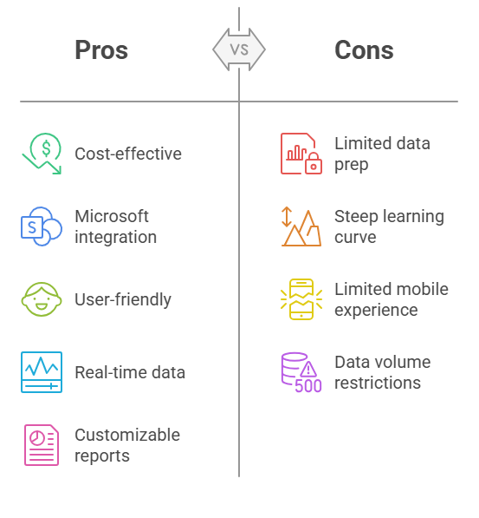
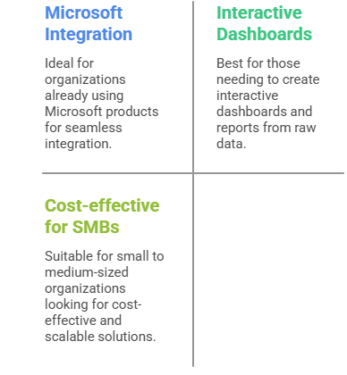
Power BI
Power BI is a business analytics tool developed by Microsoft. It enables users to visualize data, share insights across an organization, or embed them in an app or website. Provides interactive reports and dashboards, which can be used for business intelligence.
Notes:
Power BI is a comprehensive business analytics tool developed by Microsoft. It’s designed to help businesses convert raw data into insightful, interactive reports and dashboards. By using Power BI, users can easily visualize data, share their findings within an organization, or even embed these insights into external applications or websites. The main purpose of Power BI is to provide business intelligence (BI), which allows users to make data-driven decisions based on visualized insights.
When to Use Power BI?
Power BI is ideal for organizations already using Microsoft products like Excel, Azure, and SharePoint because of its seamless integration. It is especially useful for businesses that need to transform raw data into interactive insights through dynamic dashboards and reports. Power BI is cost-effective, which makes it a great choice for small to medium-sized organizations looking for a scalable solution that doesn’t break the budget. The tool is particularly helpful when real-time data analysis is needed, as it supports live data streaming.
Advantages of Power BI:
Cost-effective: Power BI has a free version that includes many useful features, while the Pro version is competitively priced, making it affordable for businesses of all sizes.
Integration with Microsoft Products: Power BI integrates smoothly with Microsoft products like Excel, Azure, and SharePoint, which makes it easy for organizations already within the Microsoft ecosystem.
User-friendly: Power BI is known for its intuitive interface, which makes it accessible to both beginners and experienced users.
Real-time data access: The tool allows businesses to access live data streams, enabling instant decision-making based on current data.
Customizable reports: Power BI offers a high level of flexibility, allowing users to create custom reports and dashboards tailored to their specific business needs.
Disadvantages of Power BI:
Limited Data Preparation Tools: While Power BI is excellent for visualizing data, its data preparation features are not as powerful or extensive as some other BI tools.
Steep Learning Curve for Advanced Features: For users who want to utilize Power BI’s more advanced features, the learning process can be challenging, requiring a significant investment of time.
Limited Mobile Experience: Although Power BI offers a mobile version, its mobile interface does not provide the same smooth experience as the desktop version.
Data Volume Restrictions: The free version of Power BI comes with data limits, and larger datasets may require additional infrastructure or the premium version.

Slide 3

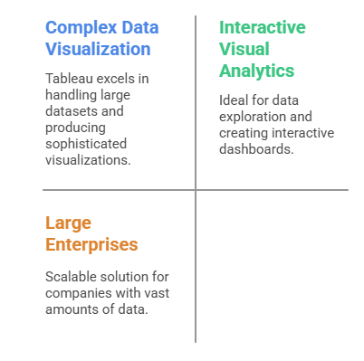
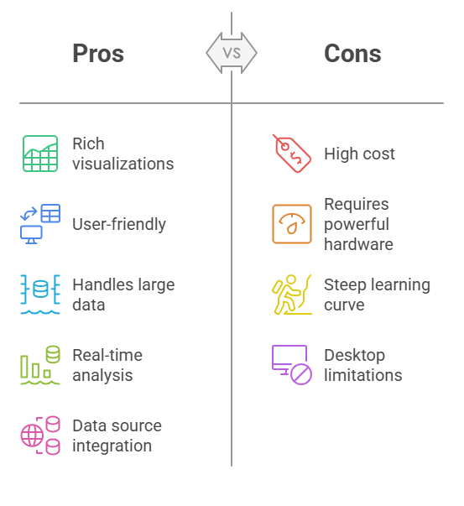
Tableau
Tableau is a data visualization tool that helps people see and understand their data. It allows users to create dashboards, graphs, and charts for data analysis and decision-making. It can connect to various data sources and create stunning visualizations from a wide range of datasets.
Notes:
Tableau is a powerful data visualization tool that helps users to see and understand their data through interactive and visually appealing dashboards, charts, and graphs. It can connect to a wide range of data sources and create stunning visualizations that support decision-making. Tableau is particularly well-suited for data exploration and analysis, allowing users to explore data in-depth by creating complex visualizations from vast datasets.
When to Use Tableau?
Tableau is best used when handling complex data visualization needs, especially when working with large datasets. It is an excellent tool for companies that require advanced visual analytics and wish to create interactive dashboards. Due to its scalability, Tableau is particularly beneficial for large enterprises with vast amounts of data that need efficient visualization and analysis. The tool’s ability to handle data at scale makes it ideal for organizations that need to analyze big data and uncover trends or insights from large datasets.
Advantages of Tableau:
Rich Visualization Options: Tableau offers a variety of advanced visualization features such as heat maps, scatter plots, and waterfall charts that help users create intricate visual displays of their data.
Ease of Use: The drag-and-drop interface makes it simple for beginners to start creating visualizations without needing to code or have prior technical knowledge.
Powerful Data Handling: Tableau is designed to handle large datasets efficiently, making it a great choice for businesses that need to manage and analyze big data.
Real-time Data Analysis: Tableau supports real-time data analysis, enabling users to update visualizations instantly as new data is added.
Integration with Many Data Sources: Tableau can connect to multiple data sources like SQL, Google Analytics, and Excel, making it versatile for a wide range of data integration needs.
Disadvantages of Tableau:
Costly: Tableau’s pricing can be expensive, particularly for large organizations or when advanced features are needed.
Requires Powerful Hardware: For handling large datasets, Tableau requires a computer with powerful hardware to ensure smooth performance, especially with more complex visualizations.
Complexity for Beginners: While the interface is user-friendly, advanced features and the full potential of Tableau may take time to master, which could be challenging for new users.
Limited to Desktop: Although Tableau offers a cloud version, the desktop version is more restrictive for large teams or enterprises unless they opt for the enterprise version.

Slide 4
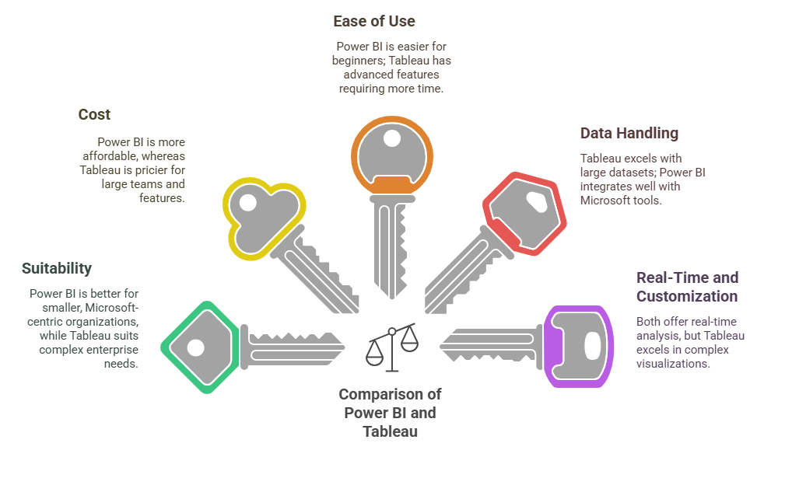
5 Key Learning Points of this Lesson
Notes:
Power BI and Tableau are both powerful data visualization tools, but they cater to different audiences. Power BI is well-suited for smaller organizations and businesses already using Microsoft products like Excel and Azure. It is more cost-effective and easier for beginners. In contrast, Tableau is better suited for larger enterprises with complex data needs. It excels in creating advanced visualizations and handling large datasets efficiently.
Cost Considerations
One key difference between Power BI and Tableau is the cost. Power BI is more affordable, especially for small and medium-sized businesses, with a free version available. Tableau, on the other hand, is more expensive, especially when purchasing the enterprise version with advanced features for large teams.
Ease of Use
Power BI is generally easier for beginners due to its user-friendly interface, making it a good starting point for organizations new to business intelligence tools. Tableau, while easy to use for basic features, offers more advanced functionalities that take longer to learn, making it a better fit for users with more technical expertise.
Data Handling and Integration
Tableau is known for its ability to handle large datasets and produce sophisticated visualizations. It integrates well with a variety of data sources, making it ideal for enterprises with big data. Power BI is highly integrated with Microsoft tools, making it the best choice for organizations already using products like Excel and SharePoint.
Real-Time Data and Customization
Both Power BI and Tableau allow users to access and analyze real-time data. However, Tableau leads in terms of creating highly customized and interactive visualizations. Power BI also offers customization but is often more streamlined for users seeking straightforward, practical reports and dashboards.

Slide 5
Thank You!
Shahriar’s Analytical Academy

